Slide 1

THIRD EYE
A MOBILE APPLICATION FOR VISUALLY IMPAIRED PEOPLE TO ASSIST WITH DAILY TASKS
22_23-J 83

Slide 2
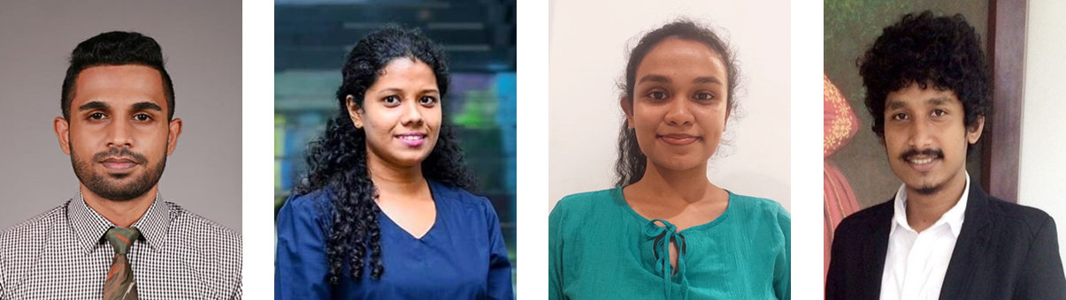

OUR TEAM
M.C.J. Costa
IT17088138
A.D. Amarasinghe
IT19133614
K.D.J. Jayasekara
IT19103600
A.M.N.D Aththanayake
IT19981918
Supervisor – Ms. Uthpala Samarakoon
Co-Supervisor – Ms. Suriyaa Kumari
20/04/2023

Slide 3
RESEARCH PROBLEM
There’s no better product or software that can easily used by the visually impaired people to do their daily tasks easily.
• Limitations and problems in existing mobile applications
• Unaffordable high cost
• Security vulnerabilities and restrictions
• Don’t fulfil blind people requirements (navigation, objects recognitions)
• Evaluating color blindness type does not exist
• Real time support not existing
• Usability issues
20/04/2023

Slide 4
OBJECTIVES
MAIN OBJECTIVE
Implement an application that can guide and assist blind people and visually troubled individuals. They can have support in which areas they have difficulties. Their difficulties can be overcome by this system which is fully automated with a built-in voice assistant and utilities that can support each of these said groups.
20/04/2023

Slide 5
OBJECTIVES
SUB OBJECTIVES
Implement real time map navigation with a voice assistant support and suggestions to navigations where the distance can be reduced.
1
2
Implement real time text capturing and reading to assist blind users to understand languages. While weather forecasting can support when navigating through destination.
3
Implement object identifying when navigating through the journey to assist with obstacles, road signs as well as distances calculating to forecast collision detection.
Implement utilities where a colorblind user can minimize the difficulties they face when trying to identify color related elements for day-to-day activities. Support colorblind types by testing and evaluating which type of colorblindness is present and supporting throughout.
4
20/04/2023

Slide 6
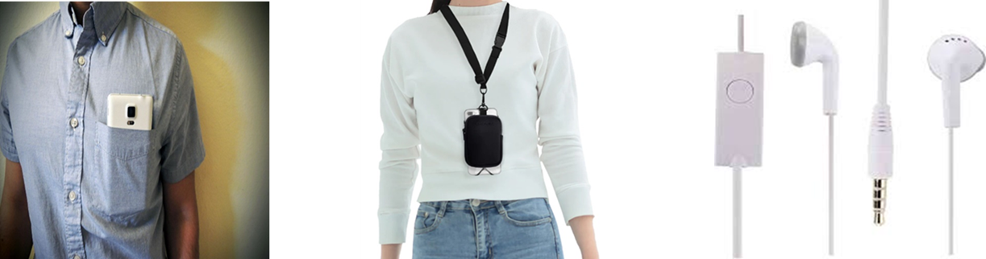
HARDWARE SOLUTION
• The back camera is used to capture the visual data
• Wireless/wired headphones are used to listen to the voice commands
• The microphone is used to give the commands
20/04/2023

Slide 7
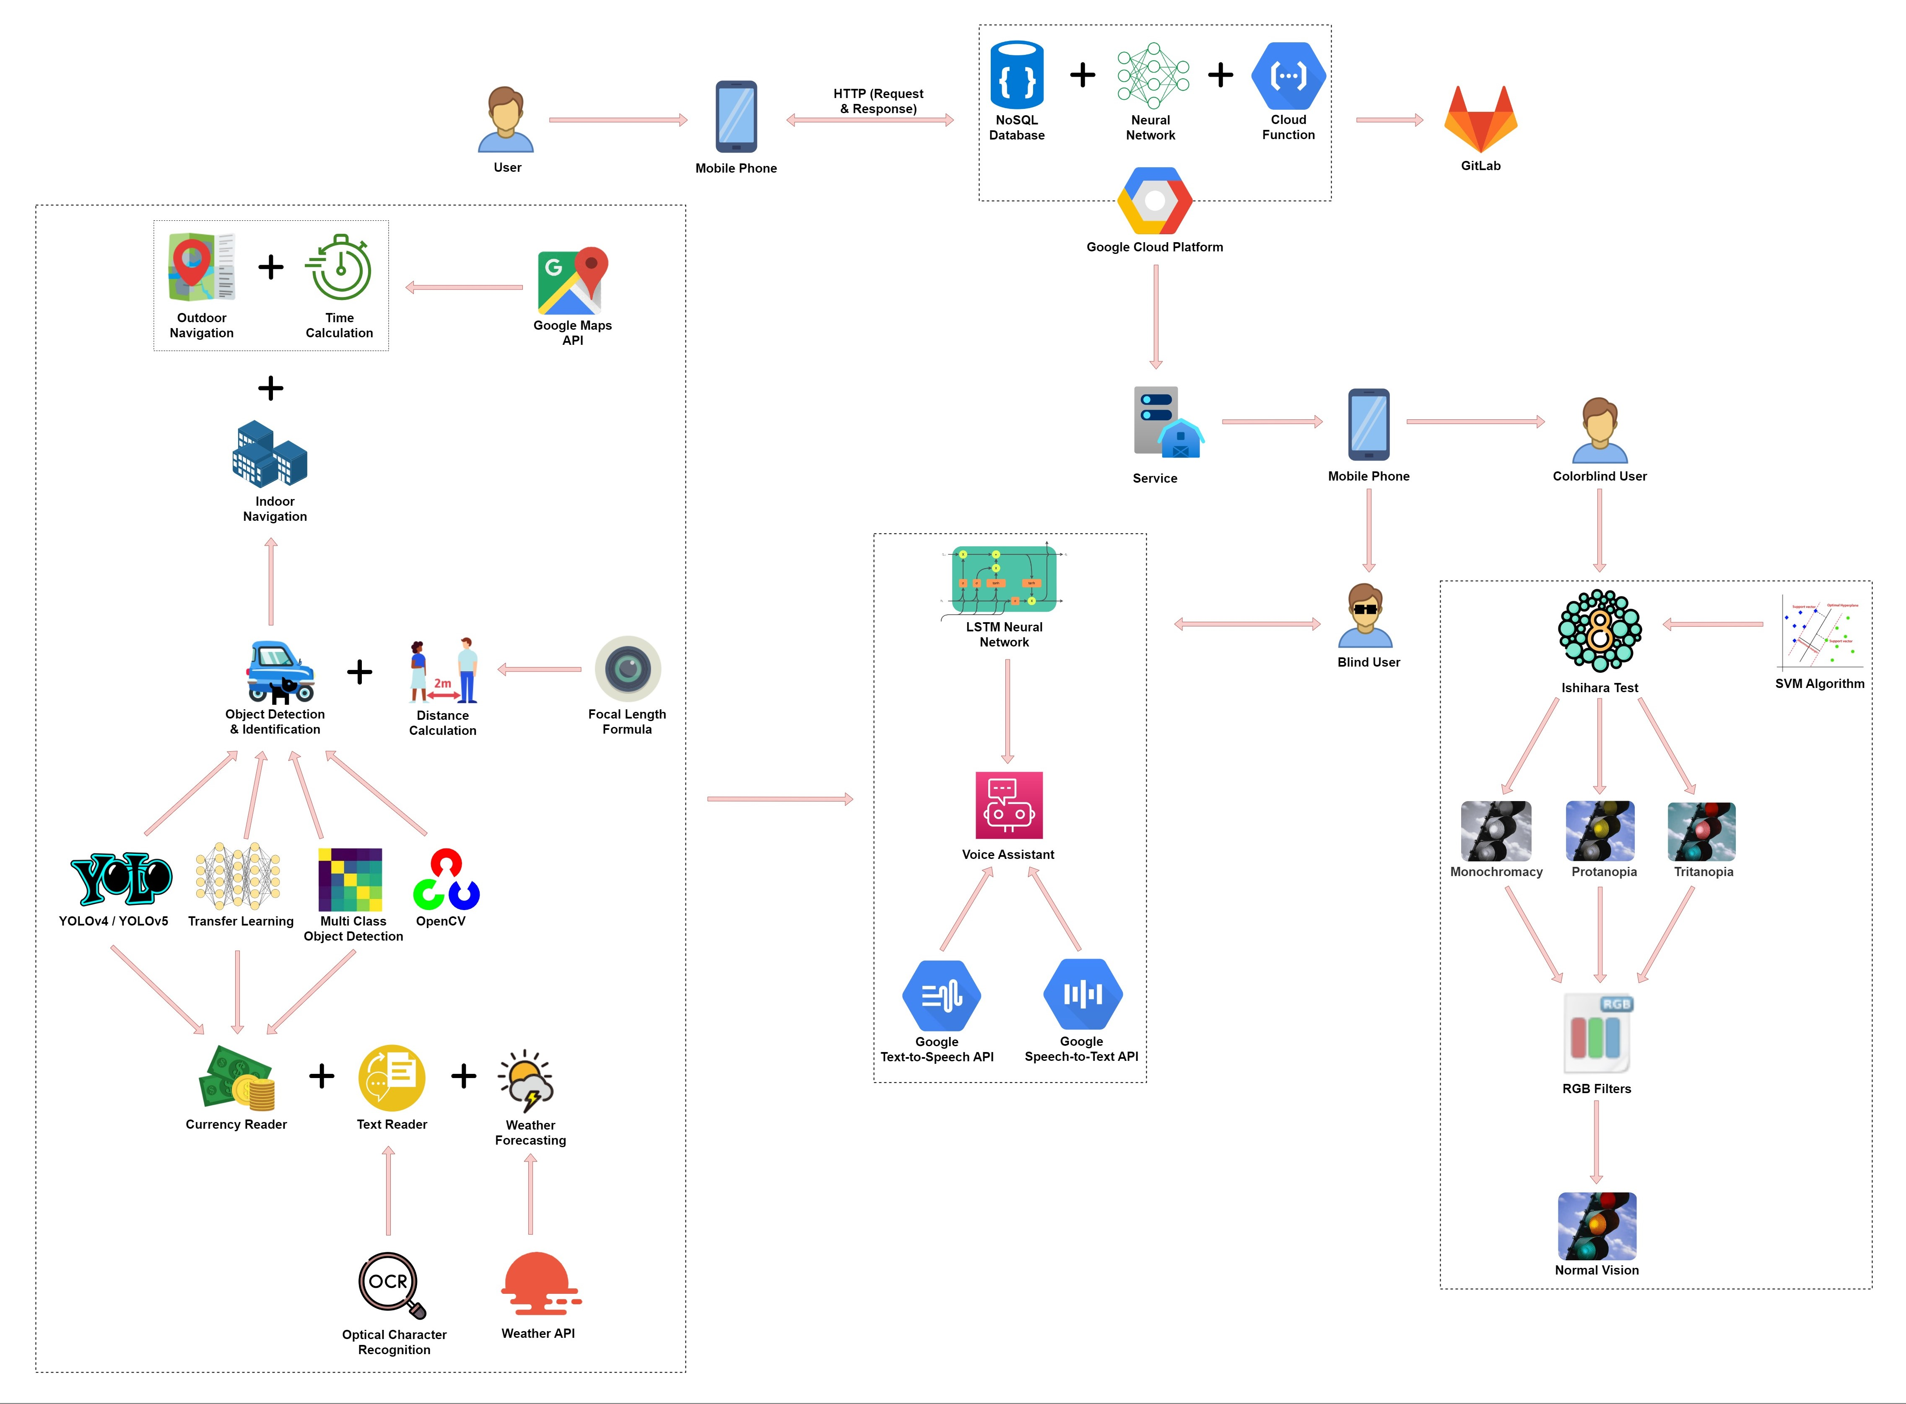
SYSTEM OVERVIEW DIAGRAM
20/04/2023

Slide 8
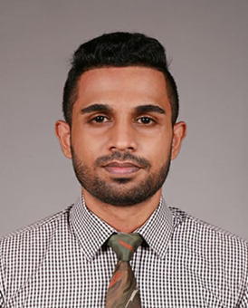
M.C.J. Costa
IT17088138
Information Technology
20/04/2023

Slide 9
RESEARCH PROBLEM
• Diagnosing a person what type of colorblindness they have.
• No current dataset supporting the users with correct color filter through the mobile device.
• Creating model to support Ishihara test.
• Create a mobile application to support the colorblind person.
IT171088138 | M.C.J. Costa | 22_23-J 83
20/04/2023

Slide 10
PROPOSED SOLUTION
Implement real time support application which helps the colorblind people to get the QoL by using the smartphone accurately.
Add a display
filter depending on the evaluated result
Guide the user with feedback commands
To evaluate the type of colorblindness, create “Ishihara” tests
IT171088138 | M.C.J. Costa | 22_23-J 83
20/04/2023

Slide 11
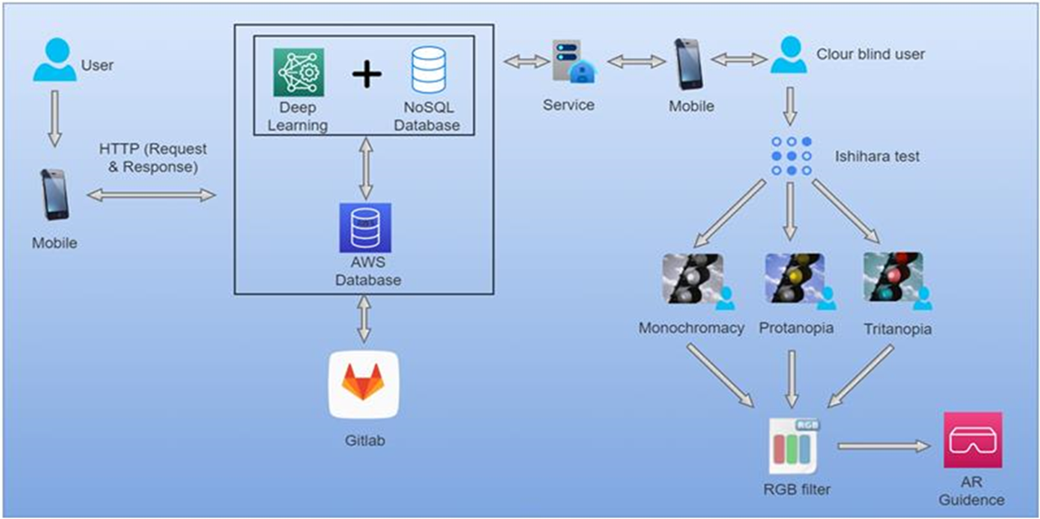
COMPONENT OVERVIEW DIAGRAM
IT171088138 | M.C.J. Costa | 22_23-J 83
20/04/2023

Slide 12

CURRENT PROGRESS 90%
✓ Collected Ishihara diagnostics plates and data.
✓ Implemented a dataset using a gathered dataset and trained it.
✓ Created a custom model to identify different type of colorblind diagnosis.
✓ Developed a custom script to get the user input to finalize the color blindness conditions.
✓ Used the test results to implement a custom filters for user’s mobile.
✓ Created and developed the model in cloud to use it anywhere with a lesser number of performance lag.
✓ Created a mobile application with UI to handle the Ishihara test.
IT171088138 | M.C.J. Costa | 22_23-J 83
20/04/2023

Slide 13
NEXT EXPECTED PROGRESS 100%
✓ Improve UX when Ishihara test result response after populated.
✓ Further testing implemented camera filter .
IT171088138 | M.C.J. Costa | 22_23-J 83
20/04/2023

Slide 14
RISK MITIGATION
• Create a custom data set because no current data set.
• Training the model to display Ishihara test results with user’s inputs.
• When training the model, the number of Ishihara plates were not significant. enough to get an accurate prediction for some color blindness types.
• When training the machine learning model what type of model needs to be considered (classification).
• Choosing between support vector classification and binary classification to get the accurate prediction.
IT171088138 | M.C.J. Costa | 22_23-J 83
20/04/2023

Slide 15







TOOLS AND TECHNOLOGIES
• Kotlin
• Pytorch
• Jupyter notebook
• Anaconda environment
• Java
• Google Cloud Platform
• Android Studio
• Python
IT171088138 | M.C.J. Costa | 22_23-J 83
20/04/2023

Slide 16
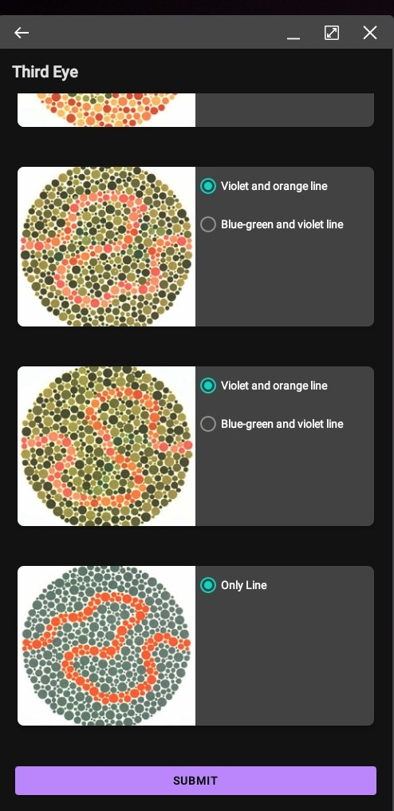
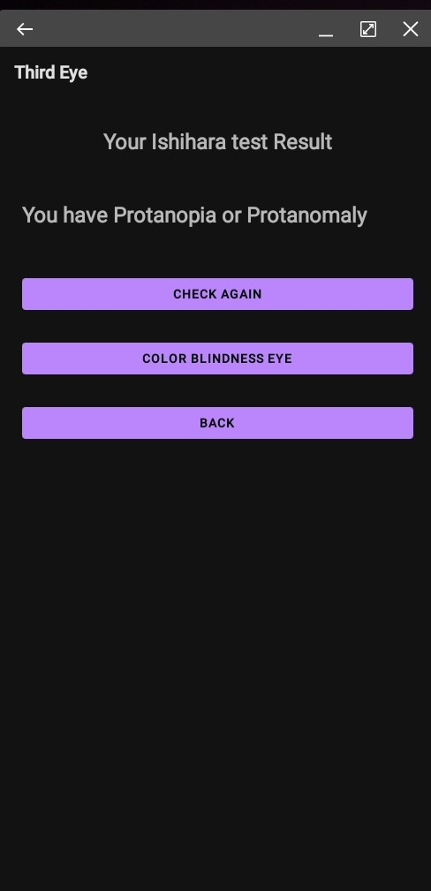
PROOF OF WORK
IT171088138 | M.C.J. Costa | 22_23-J 83
20/04/2023

Slide 17
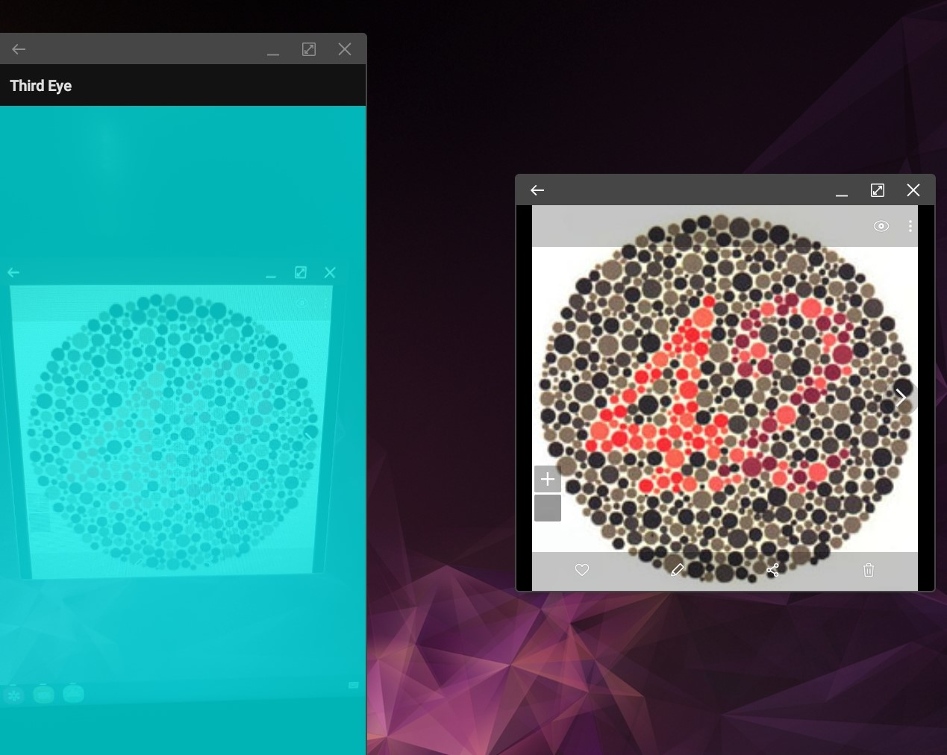
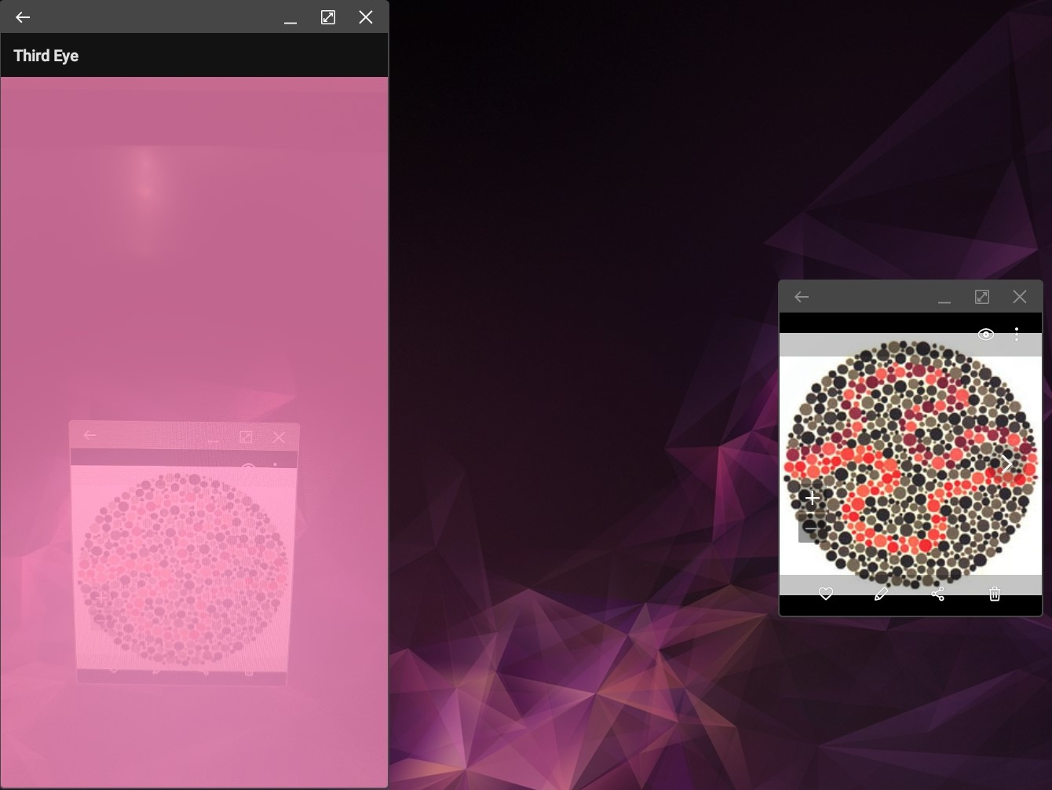
PROOF OF WORK
IT171088138 | M.C.J. Costa | 22_23-J 83
20/04/2023

Slide 18
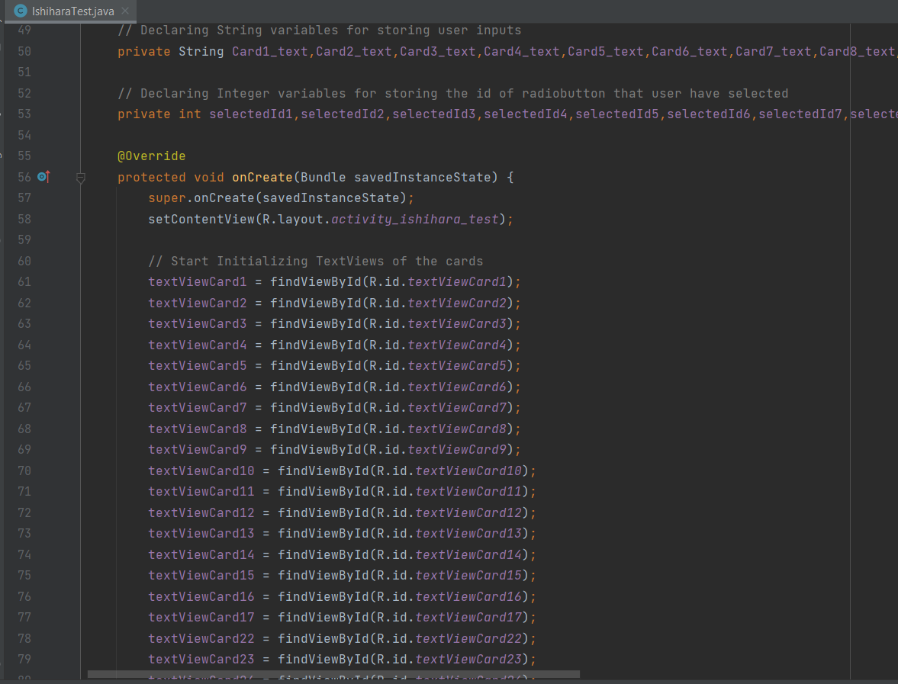
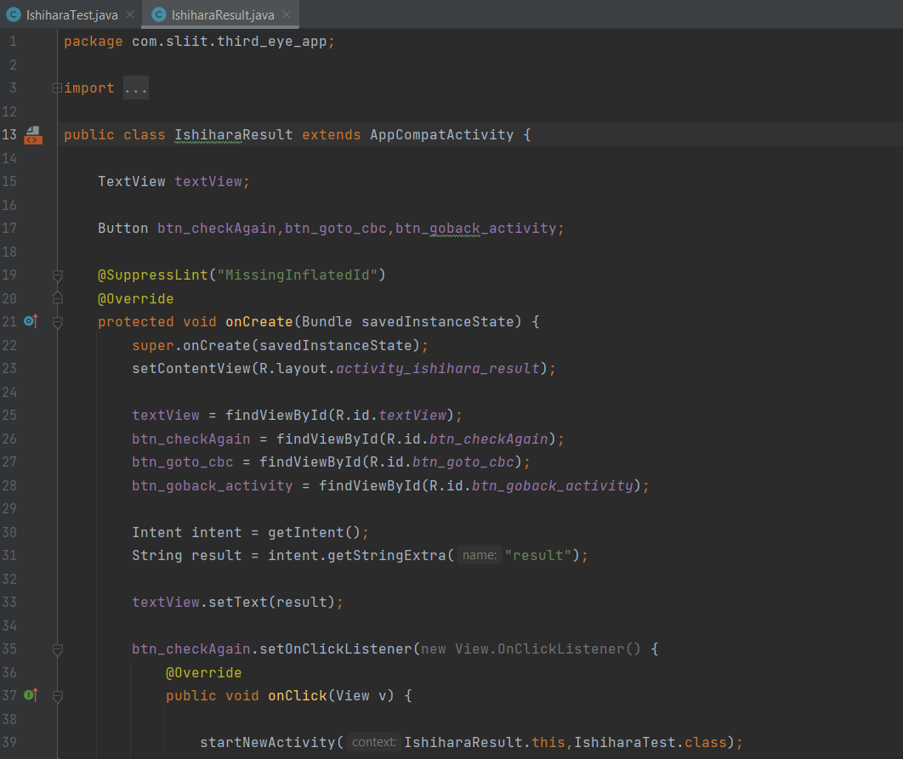
PROOF OF WORK
IT171088138 | M.C.J. Costa | 22_23-J 83
20/04/2023

Slide 19
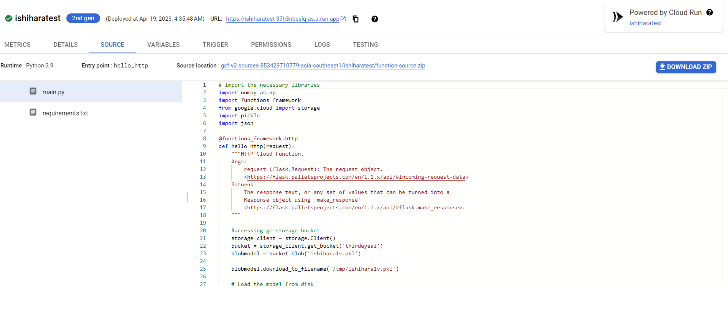
PROOF OF WORK
IT171088138 | M.C.J. Costa | 22_23-J 83
20/04/2023

Slide 20
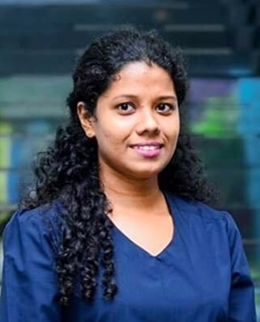
A.D. Amarasinghe
IT19133614
Information Technology
20/04/2023

Slide 21
RESEARCH PROBLEM
There’s no proper mobile application for visually impaired people to help with both indoor and outdoor navigation. And BVI people prefer voice-command-based applications rather than finger taps to accomplish their needs.
IT19133614 | A.D. Amarasinghe | 22_23-J 83
20/04/2023

Slide 22
PROPOSED SOLUTION
Implement real time map navigation with a voice assistant support and suggestions to navigations where the distance can be reduced.
Implementation of
the voice assistant to be effective, clear, and accurate when it guides the user
Accurate map navigation for both indoor and outdoor
Suggest similar
destinations and
calculate the time
to reach the
destination
IT171088138 | M.C.J. Costa | 22_23-J 83
20/04/2023

Slide 23
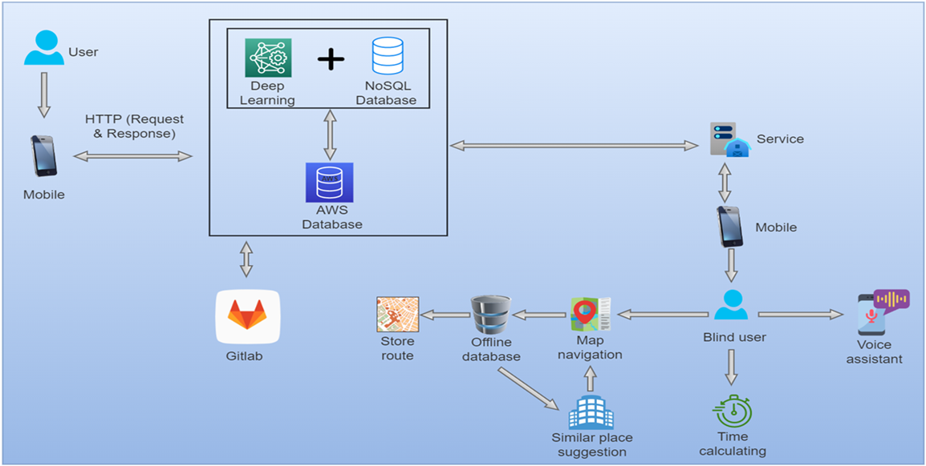
COMPONENT OVERVIEW DIAGRAM
IT19133614 | A.D. Amarasinghe | 22_23-J 83
20/04/2023

Slide 24
CURRENT PROGRESS 90%
✓ Implemented an intelligent chatbot using LSTM deep neural network algorithm which can give random responses for trained questions.
✓ Created and trained the dataset in ‘JSON’ format defining different requests and responses from server to client and vice versa.
✓ Created and develop the model in cloud to use it anywhere to reduce the performance lag.
✓ Implemented the android mobile application to properly work the text to speech function of the implemented chatbot.
IT19133614 | A.D. Amarasinghe | 22_23-J 83
20/04/2023

Slide 25
CURRENT PROGRESS 90%
✓ Implemented the outdoor navigation function with the AI assistant’s support using GPS based map.
✓ Implemented the connectivity between the chatbot and object detection function to work the indoor navigation functionality.
✓ Implemented the connectivity between the chatbot and the other components.
IT19133614 | A.D. Amarasinghe | 22_23-J 83
20/04/2023

Slide 26
NEXT EXPECTED PROGRESS 100%
✓ Improve the JSON data set so that the voice assistant can respond to more requests.
✓ Test the implemented functionalities with the users.
IT19133614 | A.D. Amarasinghe | 22_23-J 83
20/04/2023

Slide 27
RISK MITIGATION
• Indoor navigation is impossible to do practically because of the signal block, and weakness in indoor areas.
• And, without entering a floor plan or a blueprint to the system, an application can’t navigate the user to a destination.
• Augmented Reality based options give a partial solution, but it is useless to a blind person because he can’t see the directions displaying in the screen.
IT19133614 | A.D. Amarasinghe | 22_23-J 83
20/04/2023

Slide 28
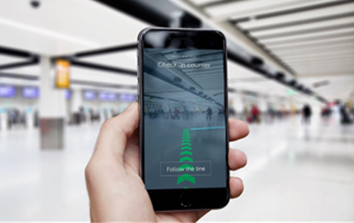
RISK MITIGATION
• The solution is to combine both voice assistant and object detection functions together to do the indoor navigation.
• Because object identifier detect vary range of obstacles in user’s walking path.
IT19133614 | A.D. Amarasinghe | 22_23-J 83
20/04/2023

Slide 29
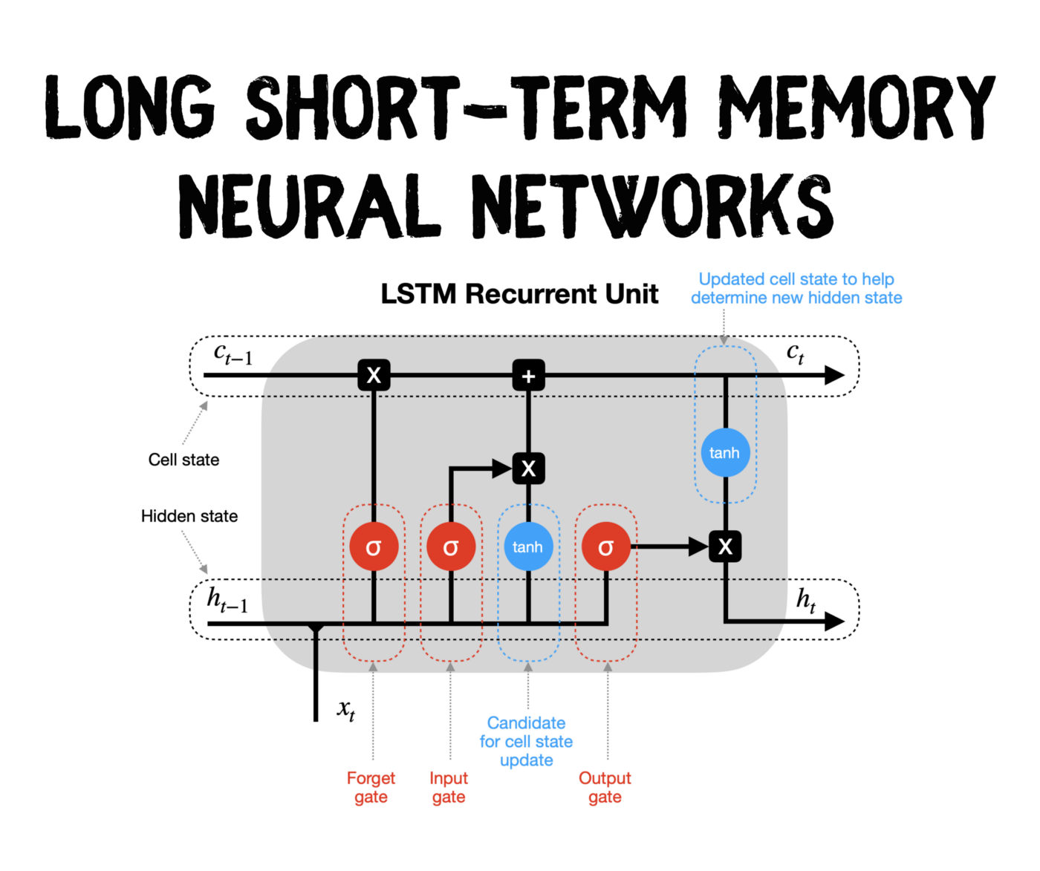


TOOLS AND TECHNOLOGIES
• LSTM neural network
• Jupyter notebook
• Anaconda environment
• NLTK tokenizer
• Json
• Google Cloud Platform
• Android Studio
• Java / Kotlin
IT19133614 | A.D. Amarasinghe | 22_23-J 83
20/04/2023

Slide 30
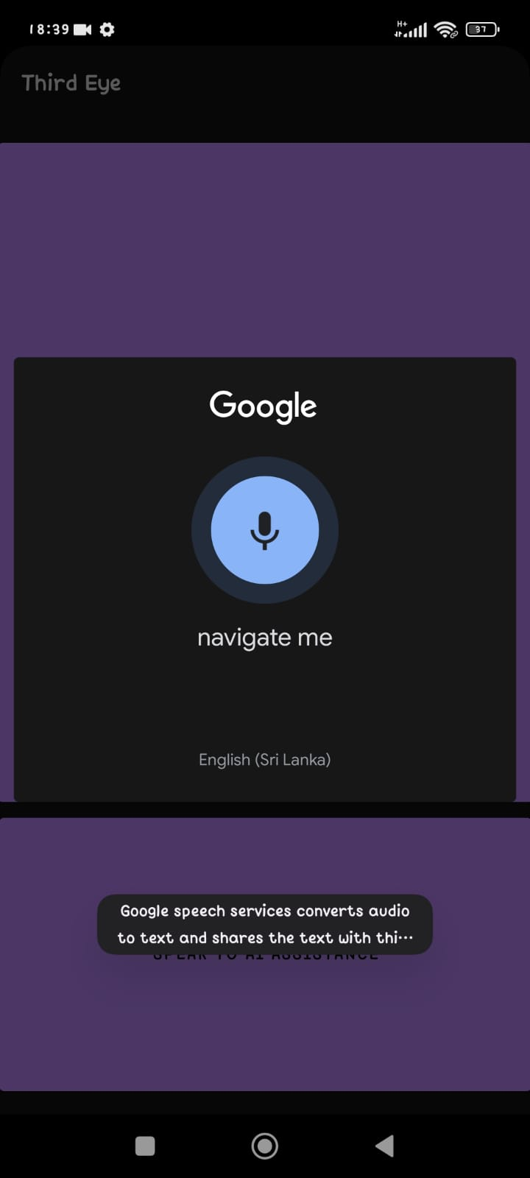
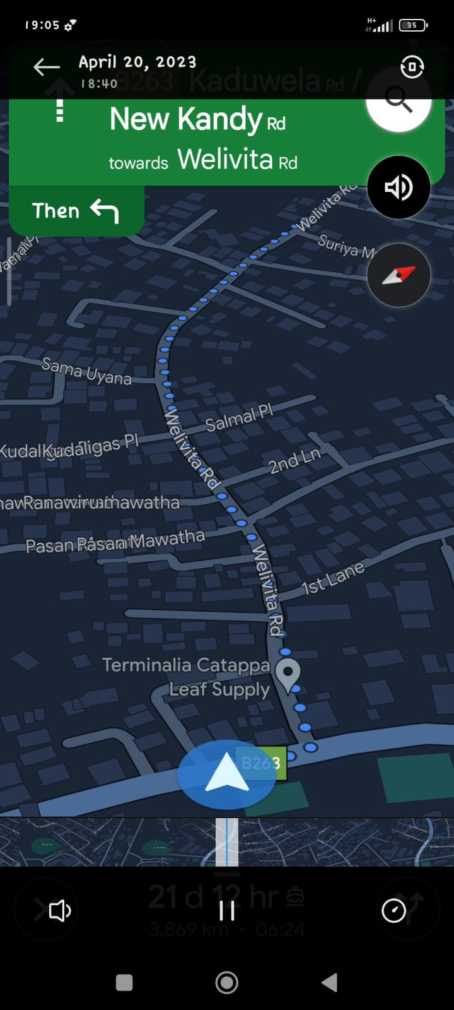
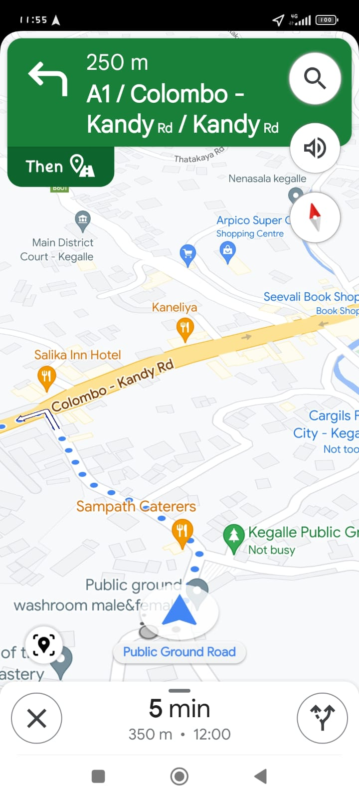
PROOF OF WORK
IT19133614 | A.D. Amarasinghe | 22_23-J 83
20/04/2023

Slide 31
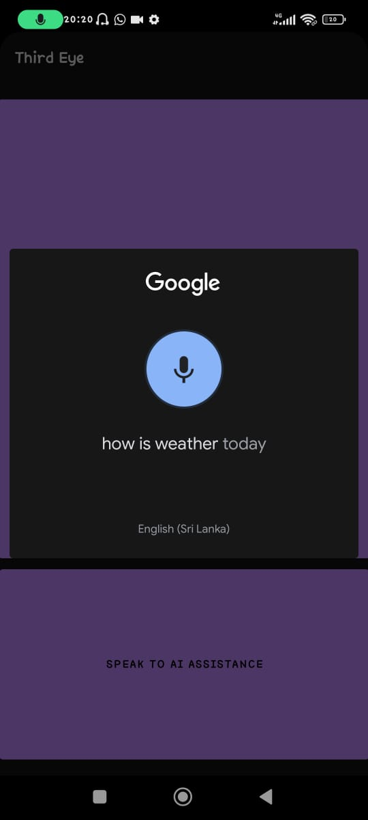
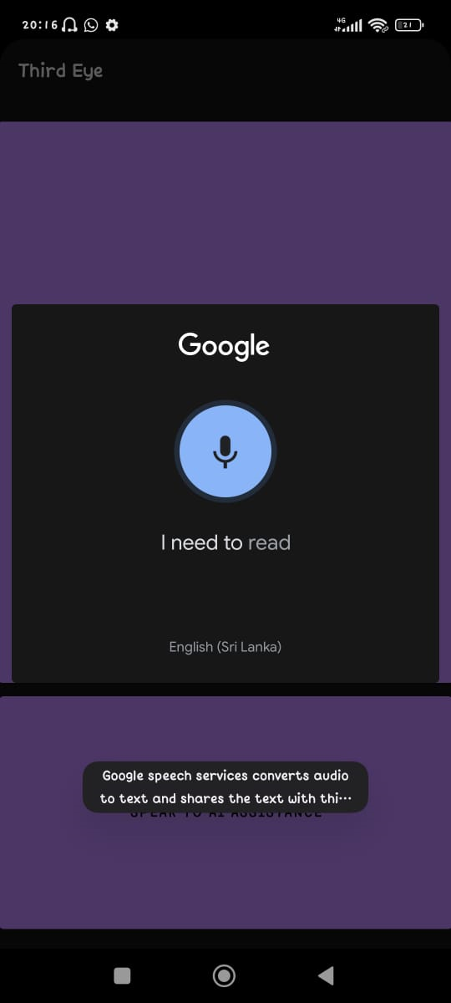
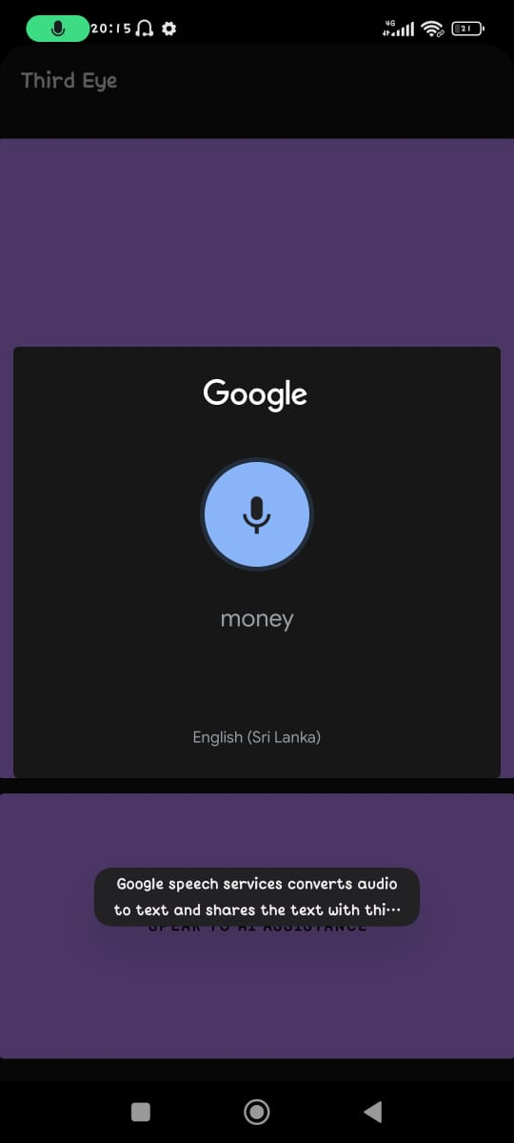
PROOF OF WORK
IT19133614 | A.D. Amarasinghe | 22_23-J 83
20/04/2023

Slide 32
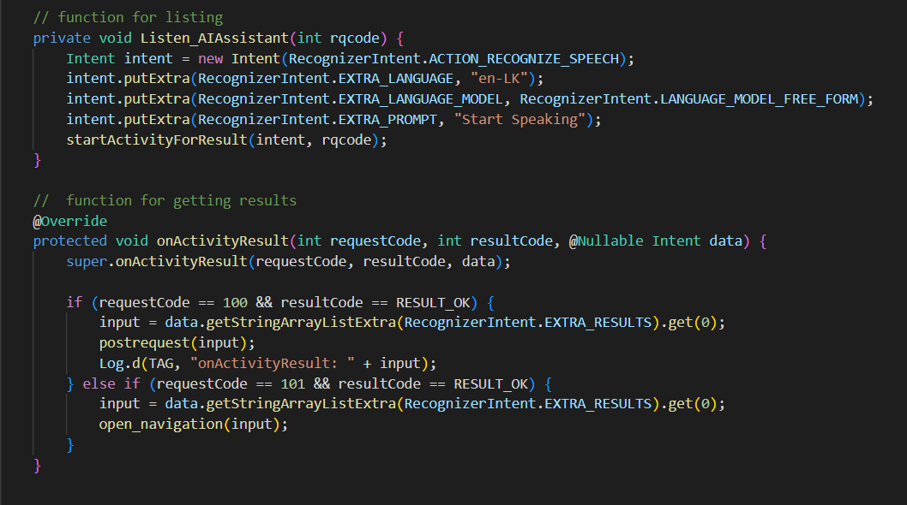
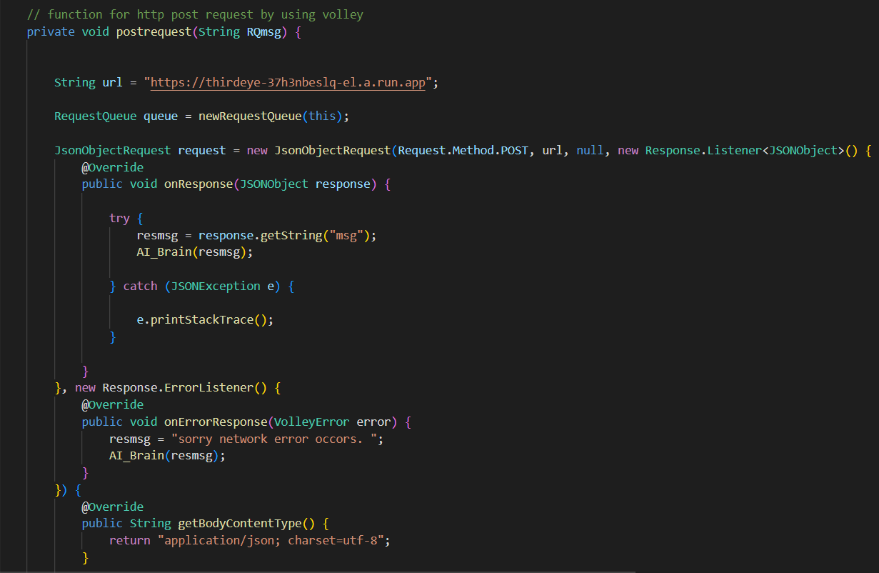
PROOF OF WORK
IT19103600 | K.D.J. Jayasekara | 22_23-J 83
20/04/2023

Slide 33
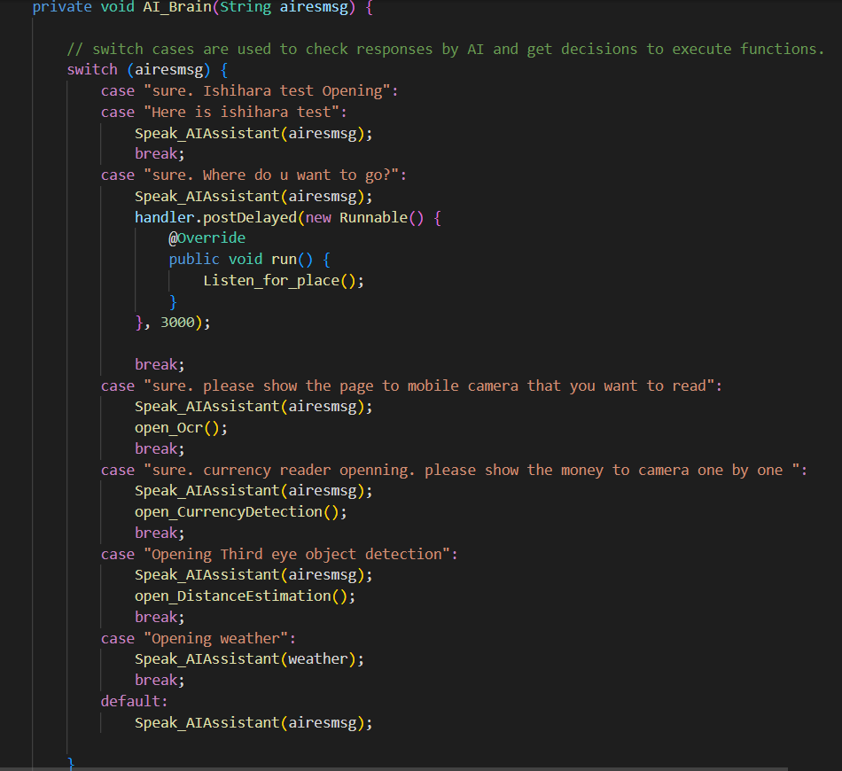
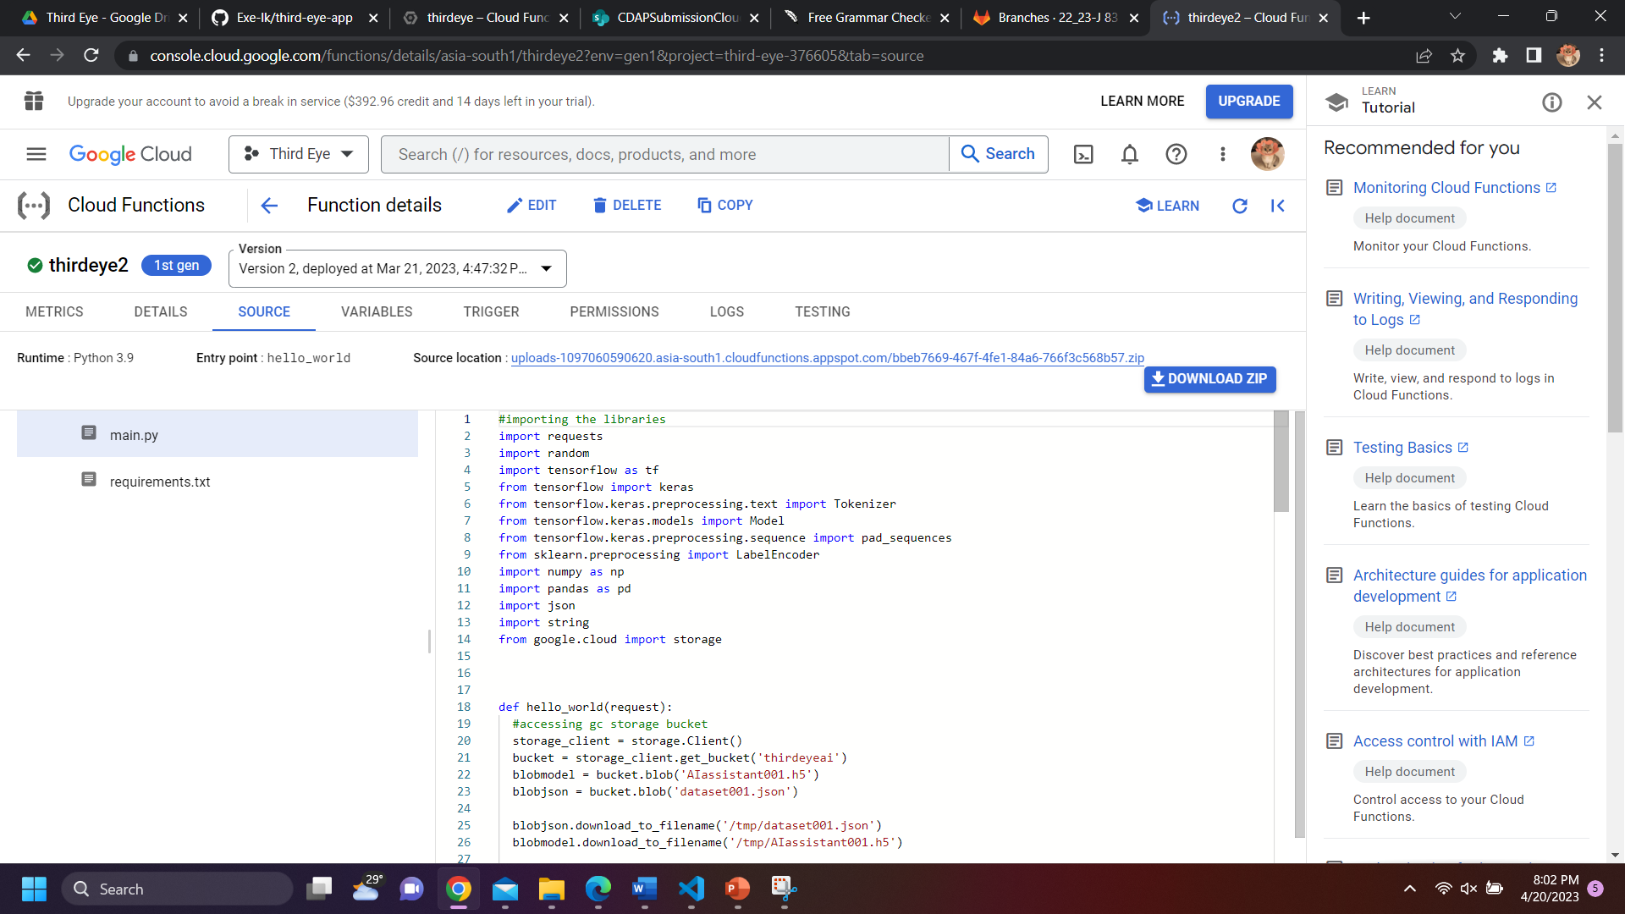
PROOF OF WORK
IT19133614 | A.D. Amarasinghe | 22_23-J 83
20/04/2023

Slide 34
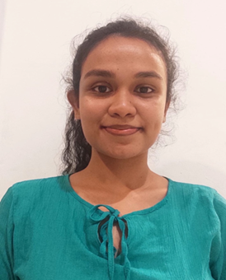
K.D.J. Jayasekara
IT19103600
Information Technology
20/04/2023

Slide 35
RESEARCH PROBLEM
• Aiding visually impaired people to identifying currency notes and coins accurately real-time
• Training a machine learning to identify the accurate outcome
• Creating a system that gives accurate weather prediction and text recognition output via an AI voice assistance
• Creating a mobile application that supports text recognition,Currency detection and weather prediction
IT19103600 | K.D.J. Jayasekara | 22_23-J 83
20/04/2023

Slide 36
PROPOSED SOLUTION
Implement real time mobile application to be assistive for blind people by implementing a text reader, weather prediction and currency reader.
Implementing real time text reading and translating functionalities
Implementing a currency notes and coins identifier
A reliable and accurate
weather forecasting system
IT19103600 | K.D.J. Jayasekara | 22_23-J 83
20/04/2023

Slide 37
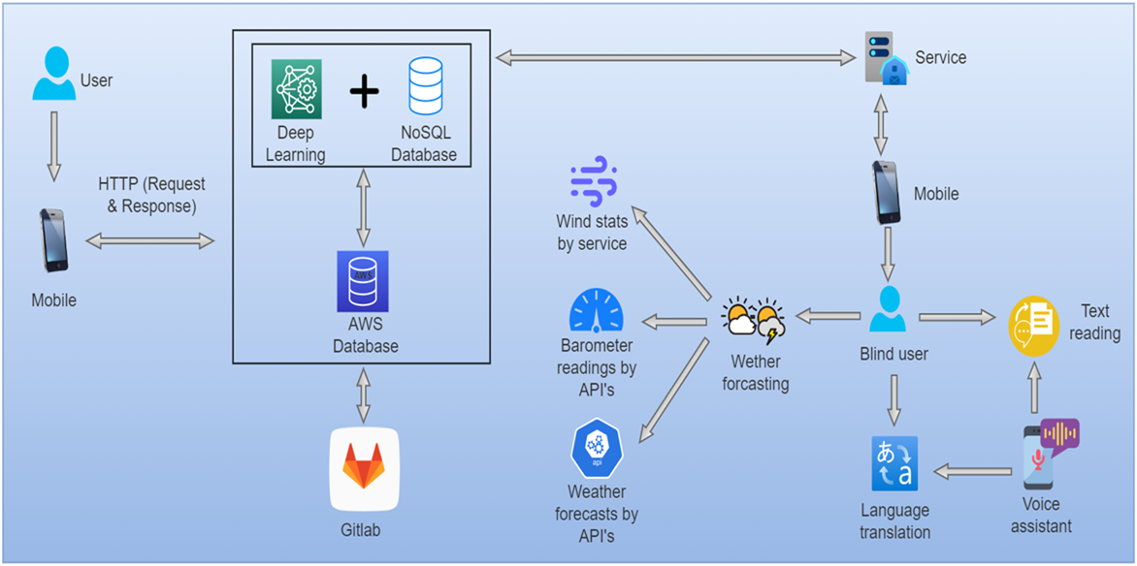
COMPONENT OVERVIEW DIAGRAM
IT19103600 | K.D.J. Jayasekara | 22_23-J 83
20/04/2023

Slide 38
CURRENT PROGRESS 90%
✓ Collected coins and notes images with different angles for each note
and coin to be later be used as the trained-test split in the model and train the model with test images.
✓ Custom YOLOV5 model which uses compound detection model to train the custom data set to identify given notes and coins in real-time.
✓ Convert custom model to pytourch version to train and deploy model to mobile device
IT19103600 | K.D.J. Jayasekara | 22_23-J 83
20/04/2023

Slide 39
CURRENT PROGRESS 90%
✓Implementing and training an OCR model to identify text on any source with the support of the best pre trained customized text recognition model in Google ML kit.
✓ Implemented a weather forecasting system with the support of a weather API
✓ Using Pytorch light and Google ML kit to implemented the model to a mobile application
IT19103600 | K.D.J. Jayasekara | 22_23-J 83
20/04/2023

Slide 40
NEXT EXPECTED PROGRESS 100%
✓ Integrating the currency recognition to the main application.
✓ Further testing.
IT19103600 | K.D.J. Jayasekara | 22_23-J 83
20/04/2023

Slide 41
RISK MITIGATION
• To implement considering which ML method to get results when identifying currency notes.
• Using YOLOV4 training model with custom made data set of images.
• Using YOLOV5 instead of YOLOV4 to enhance performs.
• Inaccurate coin identification, therefore expanding data set and different model for coins.
IT19103600 | K.D.J. Jayasekara | 22_23-J 83
20/04/2023

Slide 42

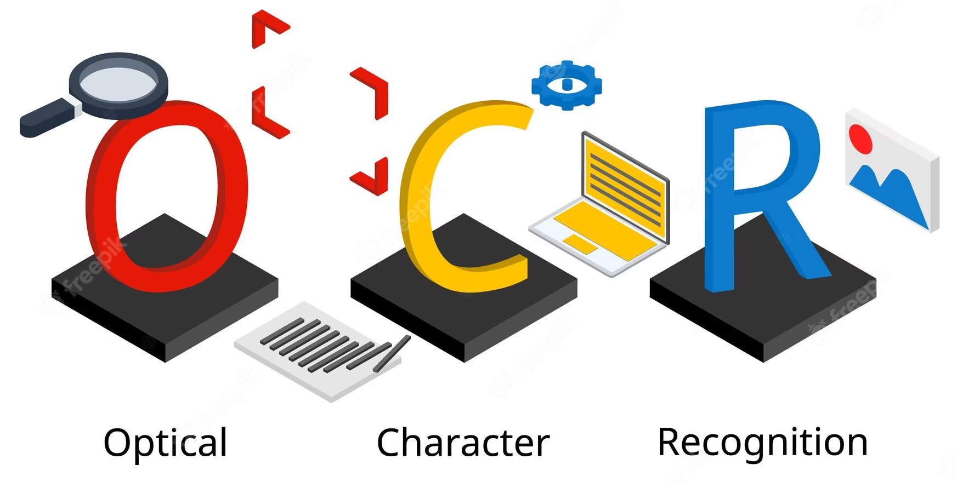



TOOLS AND TECHNOLOGIES
• YOLO5
• Pytorch
• Kotlin
• VS Code
• Java / Kotlin
• Android Studio
• Multi class object detection
• Optical Character Recognizer
IT19103600 | K.D.J. Jayasekara | 22_23-J 83
20/04/2023

Slide 43
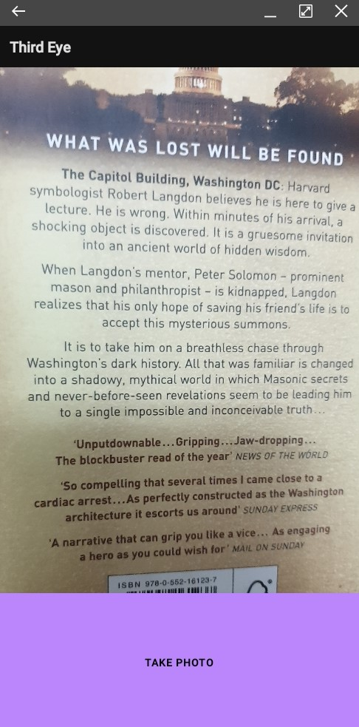
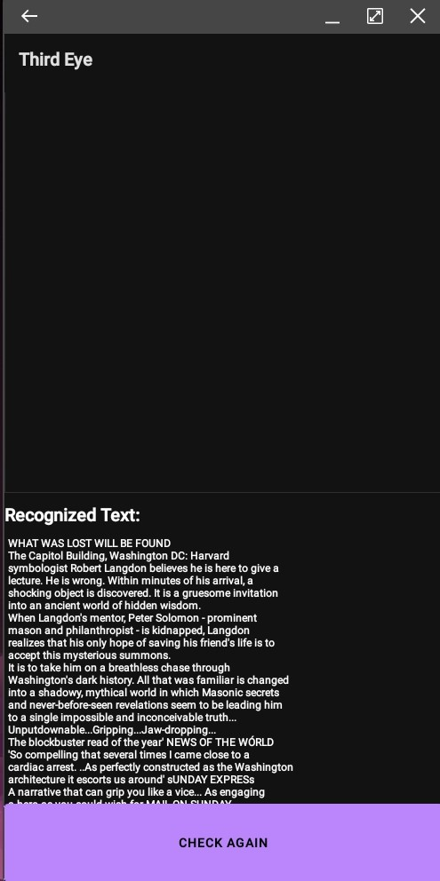
PROOF OF WORK
IT19103600 | K.D.J. Jayasekara | 22_23-J 83
20/04/2023

Slide 44
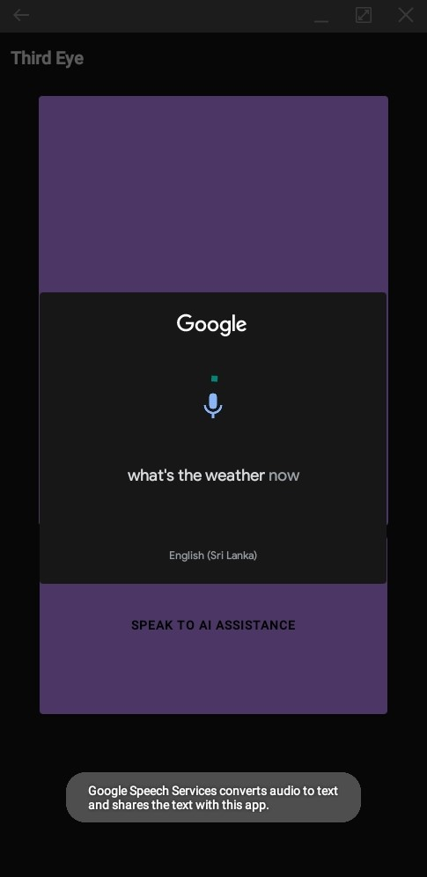
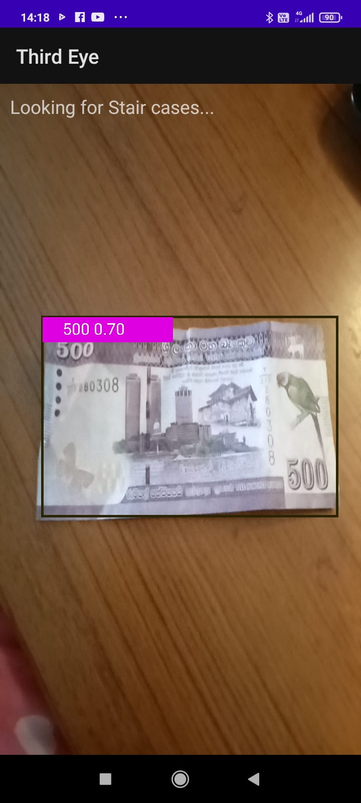
PROOF OF WORK
IT19103600 | K.D.J. Jayasekara | 22_23-J 83
20/04/2023

Slide 45
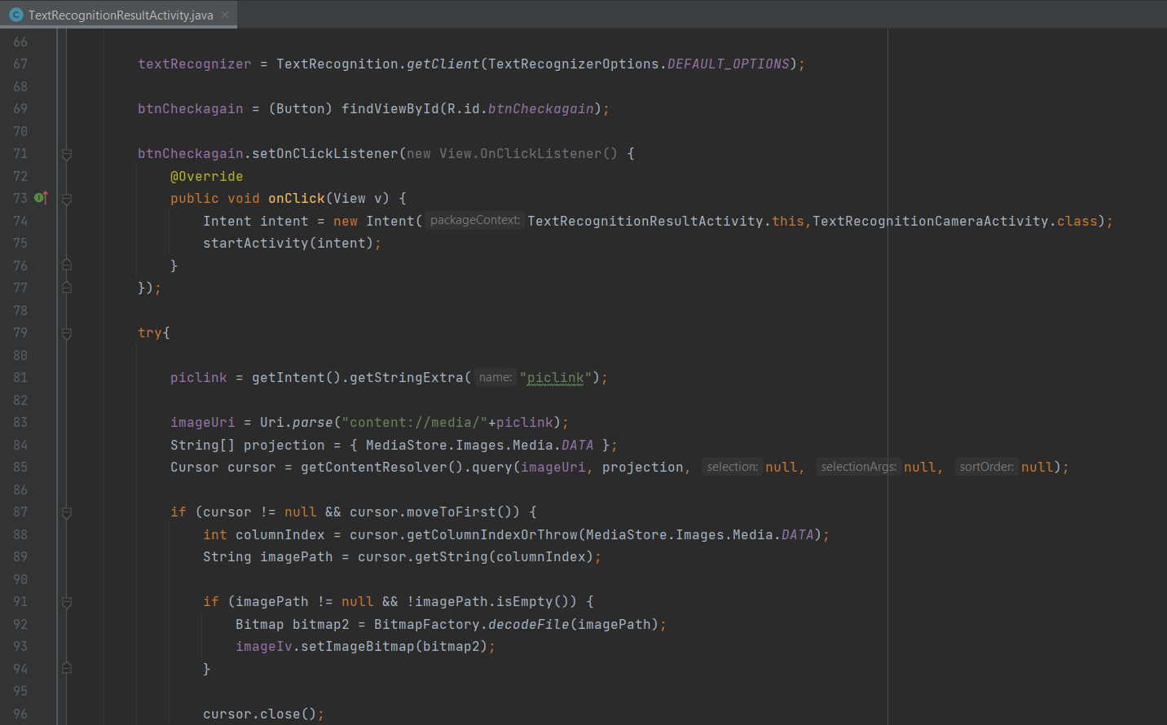
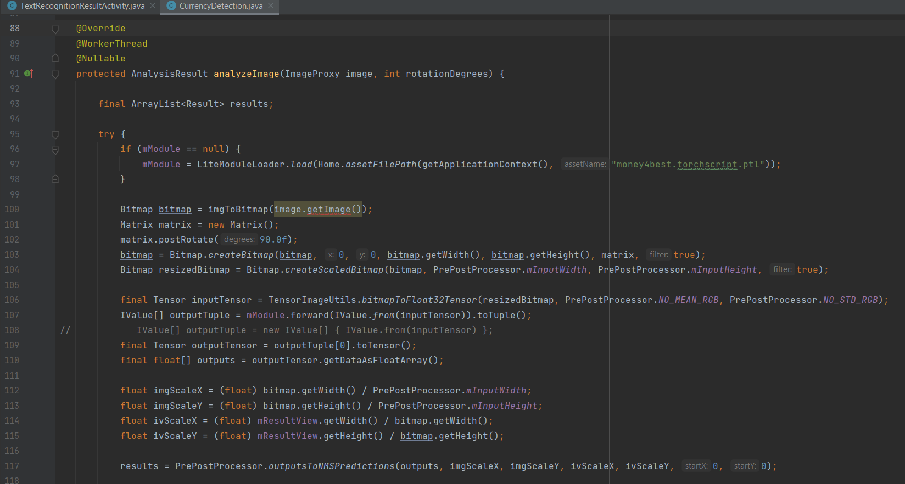
PROOF OF WORK
IT19103600 | K.D.J. Jayasekara | 22_23-J 83
20/04/2023

Slide 46
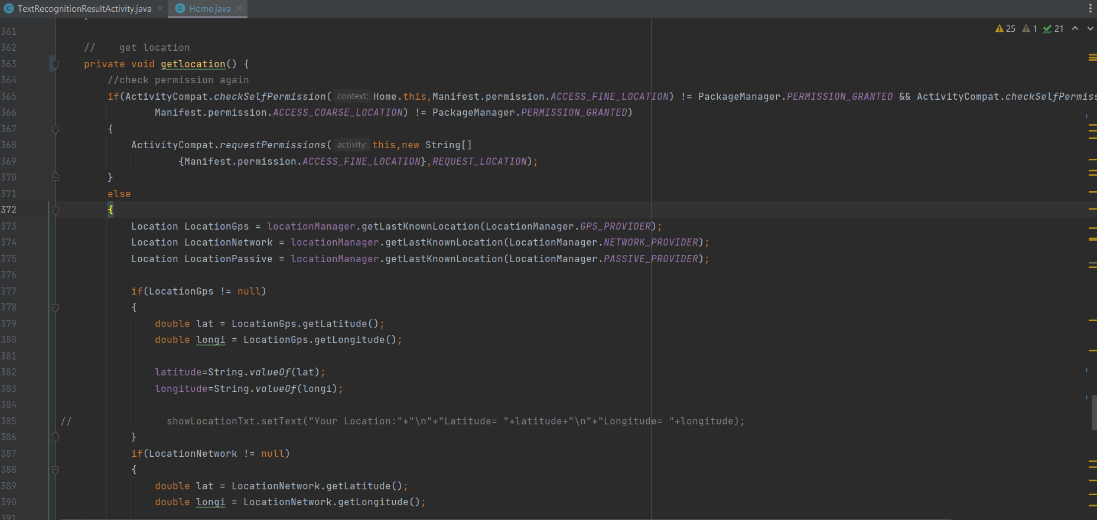
PROOF OF WORK
IT19103600 | K.D.J. Jayasekara | 22_23-J 83
20/04/2023

Slide 47
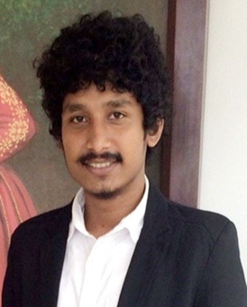
A.M.N.D. Aththanayake
IT19981918
Information Technology
20/04/2023

Slide 48
RESEARCH PROBLEM
Existing mobile apps for object detection for BVIs provide limited information about the captured objects, such as an alert sound. It is much needed to know what the app detected and how far is it located to be more prepare before an accident happens.
IT19981918 | A.M.N.D. Aththanayake | 22_23-J 83
20/04/2023

Slide 49
PROPOSED SOLUTION
Implement object identifying when navigating through the journey to assist with obstacles as well as distances calculating to forecast collision detection.
Detect and recognize in a vary range of objects
Calculate distance between the user and obstacle
Work properly in different background conditions
IT19981918 | A.M.N.D. Aththanayake | 22_23-J 83
20/04/2023

Slide 50
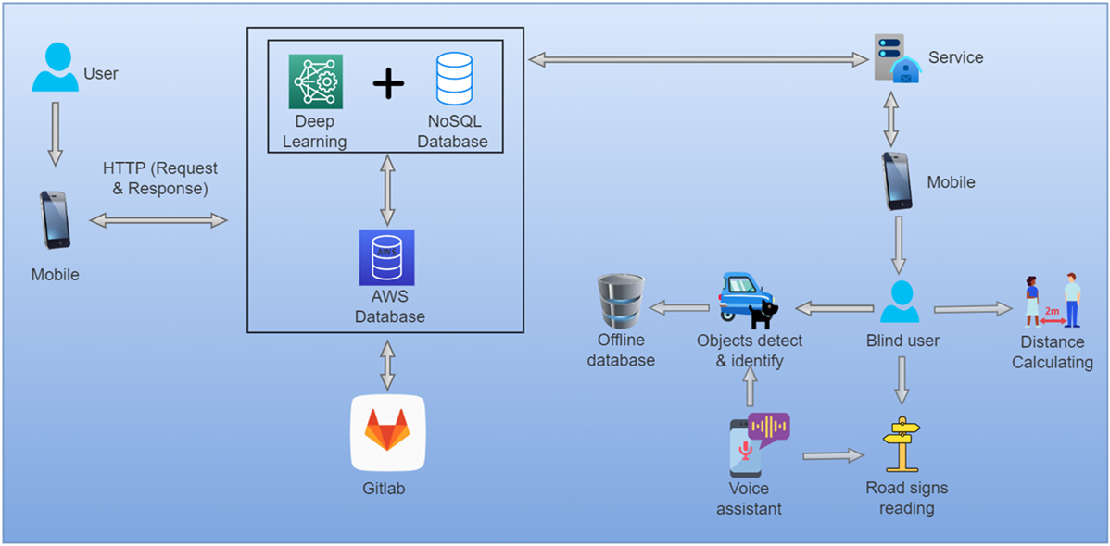
COMPONENT OVERVIEW DIAGRAM
IT19981918 | A.M.N.D. Aththanayake | 22_23-J 83
20/04/2023

Slide 51
CURRENT PROGRESS 90%
✓ Implemented a model to detect and identify objects with the accuracy value.
✓ Implemented a formula using focal length and actual length to calculate the distance to a person, frame by frame with real time capturing.
✓ The model has trained to identify vary range of objects.
✓ Improved the formula to calculate the distance for other objects.
✓ Implemented the model to detect objects even in low light conditions.
✓ Connected the model with the voice assistant.
IT19981918 | A.M.N.D. Aththanayake | 22_23-J 83
20/04/2023

Slide 52
NEXT EXPECTED PROGRESS 100%
✓ Improve the formula that can calculate the distance for more objects.
✓ Testing the function with the users.
IT19981918 | A.M.N.D. Aththanayake | 22_23-J 83
20/04/2023

Slide 53
RISK MITIGATION
• Normally distance to an object can’t be calculated by trigonometry only using the camera lens. It needed external sensors or IoT devices.
• So instead of the proposed trigonometric formula, had to use ‘Focal Length’ formula to calculate the distance considering the camera lens, and reflection of the object.
• Calculation of the distance frame-by-frame can be endless loop to the voice assistant and also to the user.
• So, the voice assistant should only work after the user requesting for distance to objects.
IT19981918 | A.M.N.D. Aththanayake | 22_23-J 83
20/04/2023

Slide 54
RISK MITIGATION
• When informing the user of the detected object, it works as an endless loop that distracts the listener.
• To avoid it, the second option was to change the model to notify the detected object only once.
• But the problem is that if the camera detected two objects that belong to the same class, it didn’t inform the user of the second one.
IT19981918 | A.M.N.D. Aththanayake | 22_23-J 83
20/04/2023

Slide 55


TOOLS AND TECHNOLOGIES
• YOLO4 / YOLO5
• TensorFlow tflite
• Transfer Learning
• Multi class object detection
• OpenCV
• Google Cloud Platform
• PyCharm
• Android Studio
• Java / Kotlin
IT19981918 | A.M.N.D. Aththanayake | 22_23-J 83
20/04/2023

Slide 56
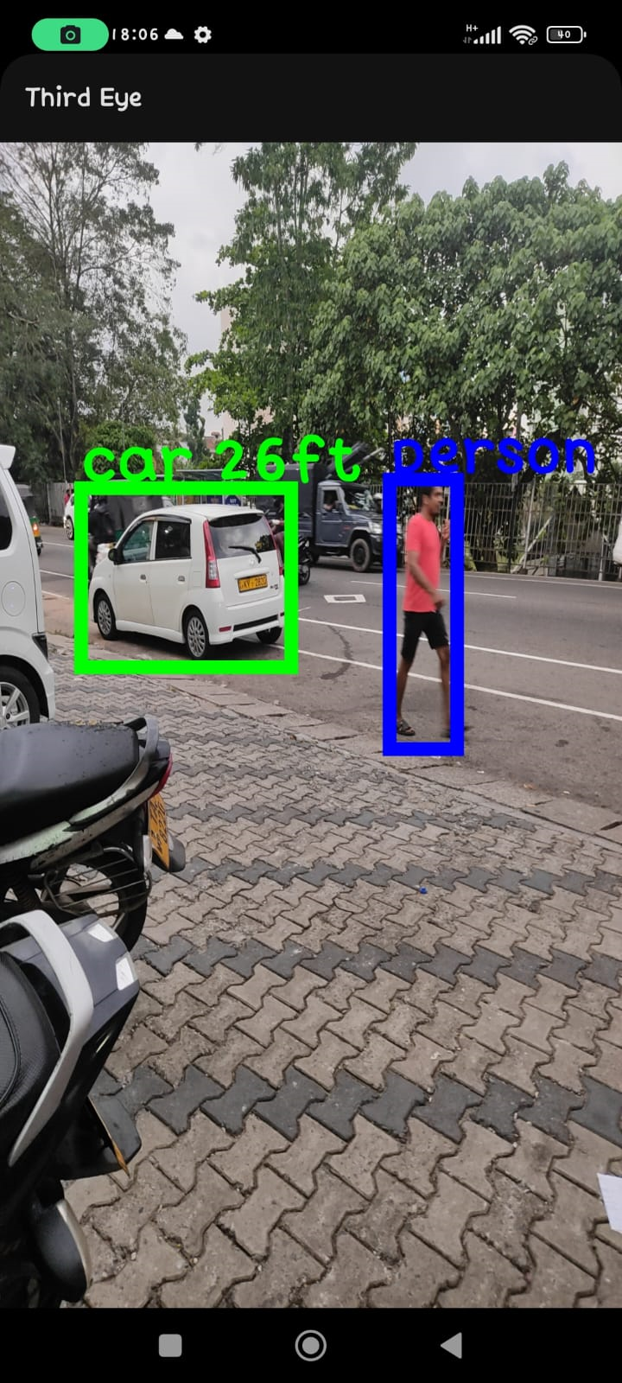
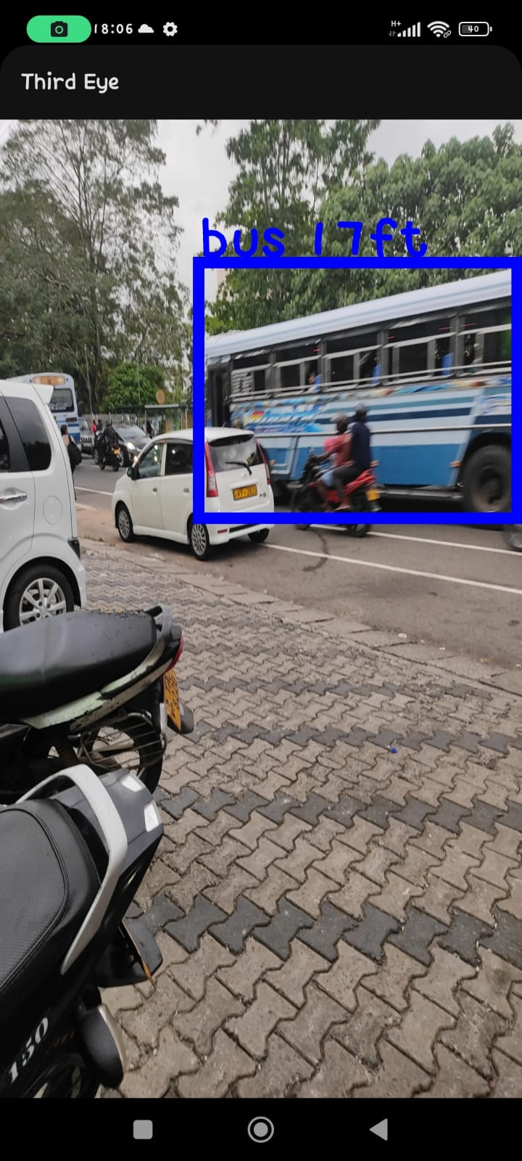
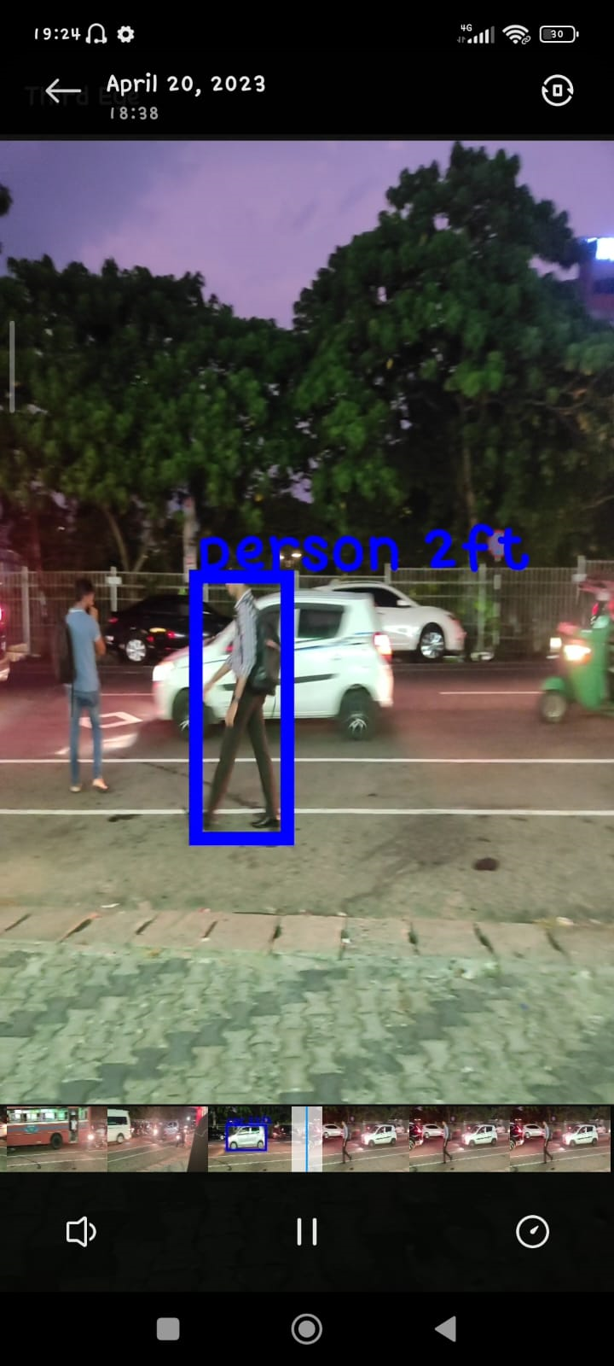
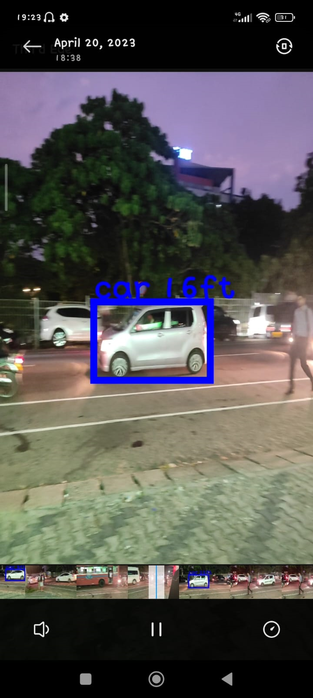
PROOF OF WORK
IT19981918 | A.M.N.D. Aththanayake | 22_23-J 83
20/04/2023

Slide 57
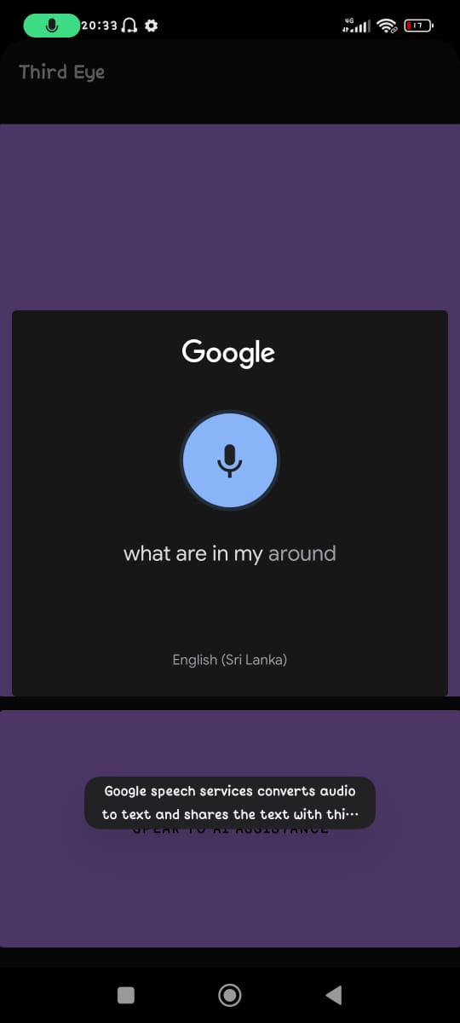
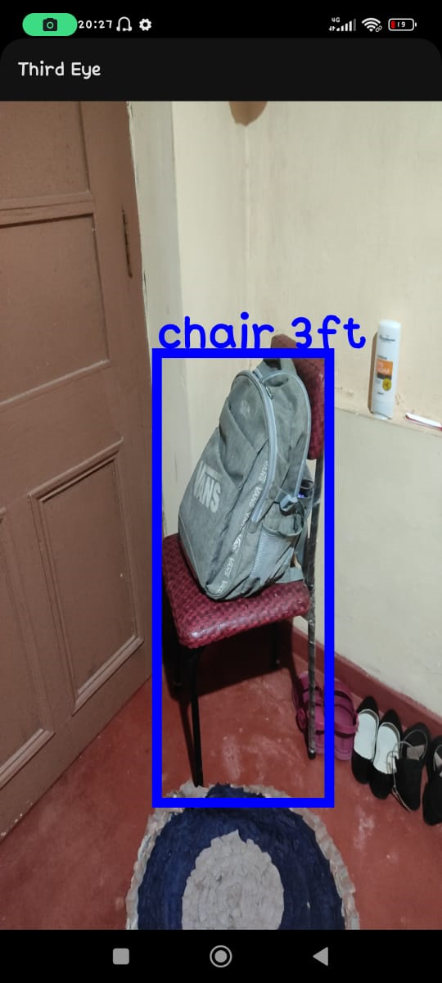
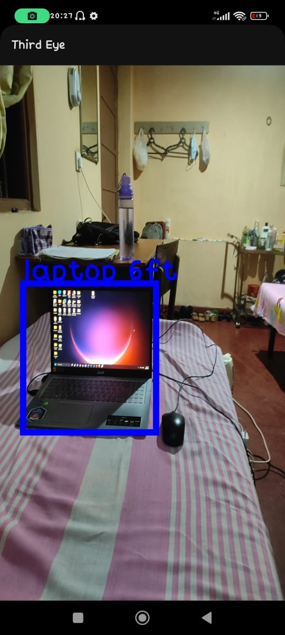
PROOF OF WORK
IT19981918 | A.M.N.D. Aththanayake | 22_23-J 83
20/04/2023

Slide 58
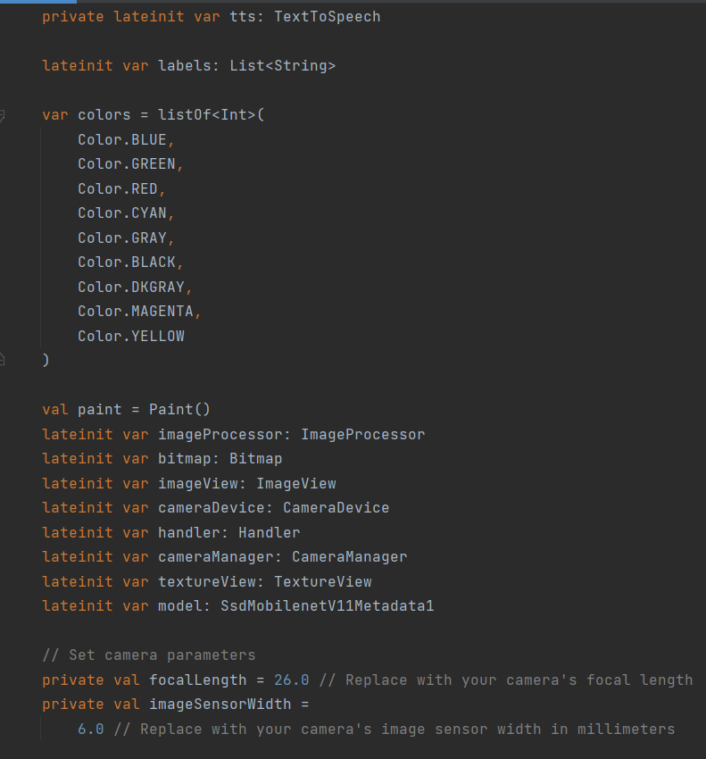
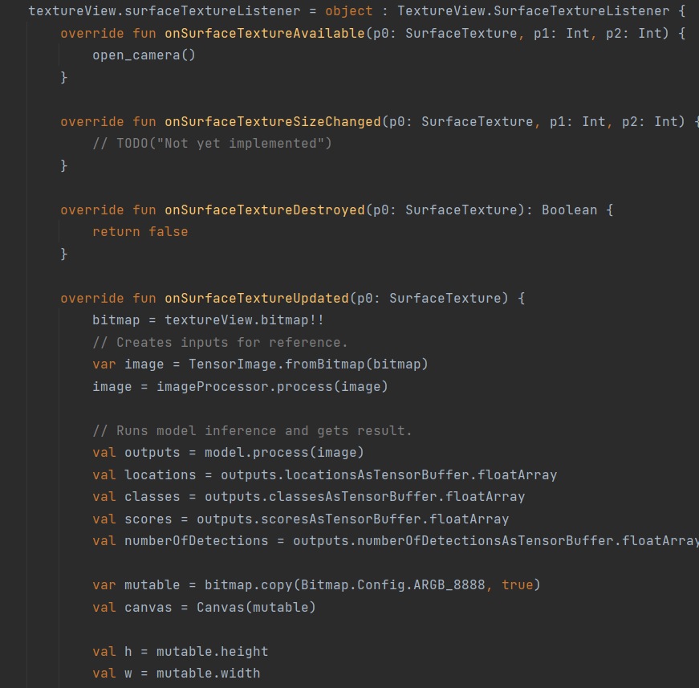
PROOF OF WORK
IT19981918 | A.M.N.D. Aththanayake | 22_23-J 83
20/04/2023

Slide 59
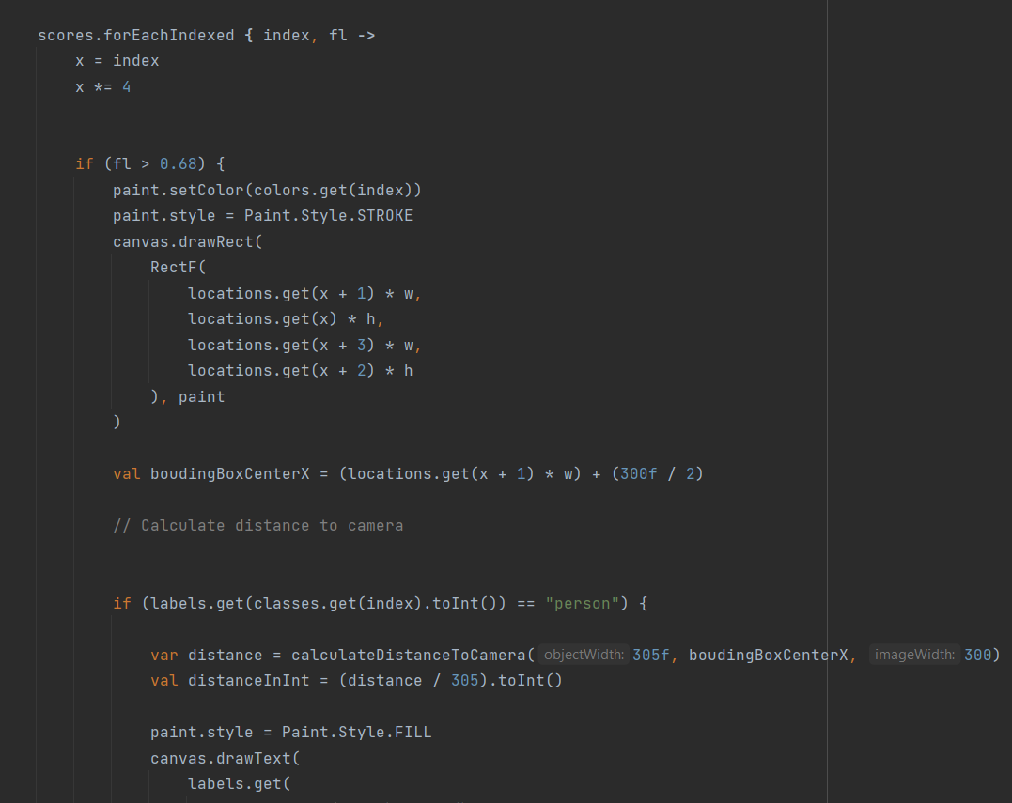
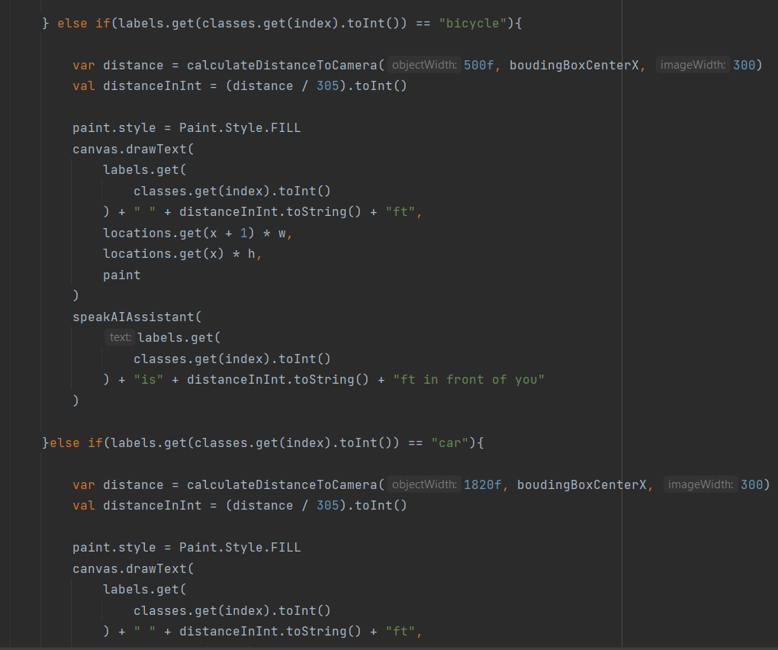
PROOF OF WORK
IT19981918 | A.M.N.D. Aththanayake | 22_23-J 83
20/04/2023

Slide 60
NEXT EXPECTED GROUP PROGRESS 100%
✓ Integrate all four components into one completed mobile application.
✓ Finalize the UI and application logo.
✓ Test the completed application with the end users by visiting the Rathmanlana School for the Blind.
IT19981918 | A.M.N.D. Aththanayake | 22_23-J 83
20/04/2023

Slide 61
PRODUCT REQUIREMENTS
USER REQUIREMENTS
SYSTEM REQUIREMENTS
• Users should be able to maintain trust in the accuracy of data.
• The system should be supportive according to the user’s demands & requests.
• The app should provide real-time information without any latency.
• The application should be easily handled by the user.
NON-FUNCTIONAL
REQUIREMENTS
• Smartphone should have at least a 20MP back camera.
• Proposed mobile app should work on both Android and iOS mobile OS.
• Android version 8 and iOS 11 or above.
• Availability
• Reliability
• Usability
• Accuracy
• Speed
• Performance
20/04/2023

Slide 62
MARKETING PLAN
ONBOARDING FREE
• Voice assistant-based map navigation
• Object detection and identification for limited objects
• Text reading for English language
• Currency notes reader
• Ishihara test and available color filters
MONTHLY
$14.99/mo
ANNUALY
$19.99/mo
• Sinhala voice assistant
• Text reader to English and Sinhala
• Augmented Reality based color filters
• Bus and train schedules
• Object detection and identification for unlimited objects
20/04/2023

Slide 63
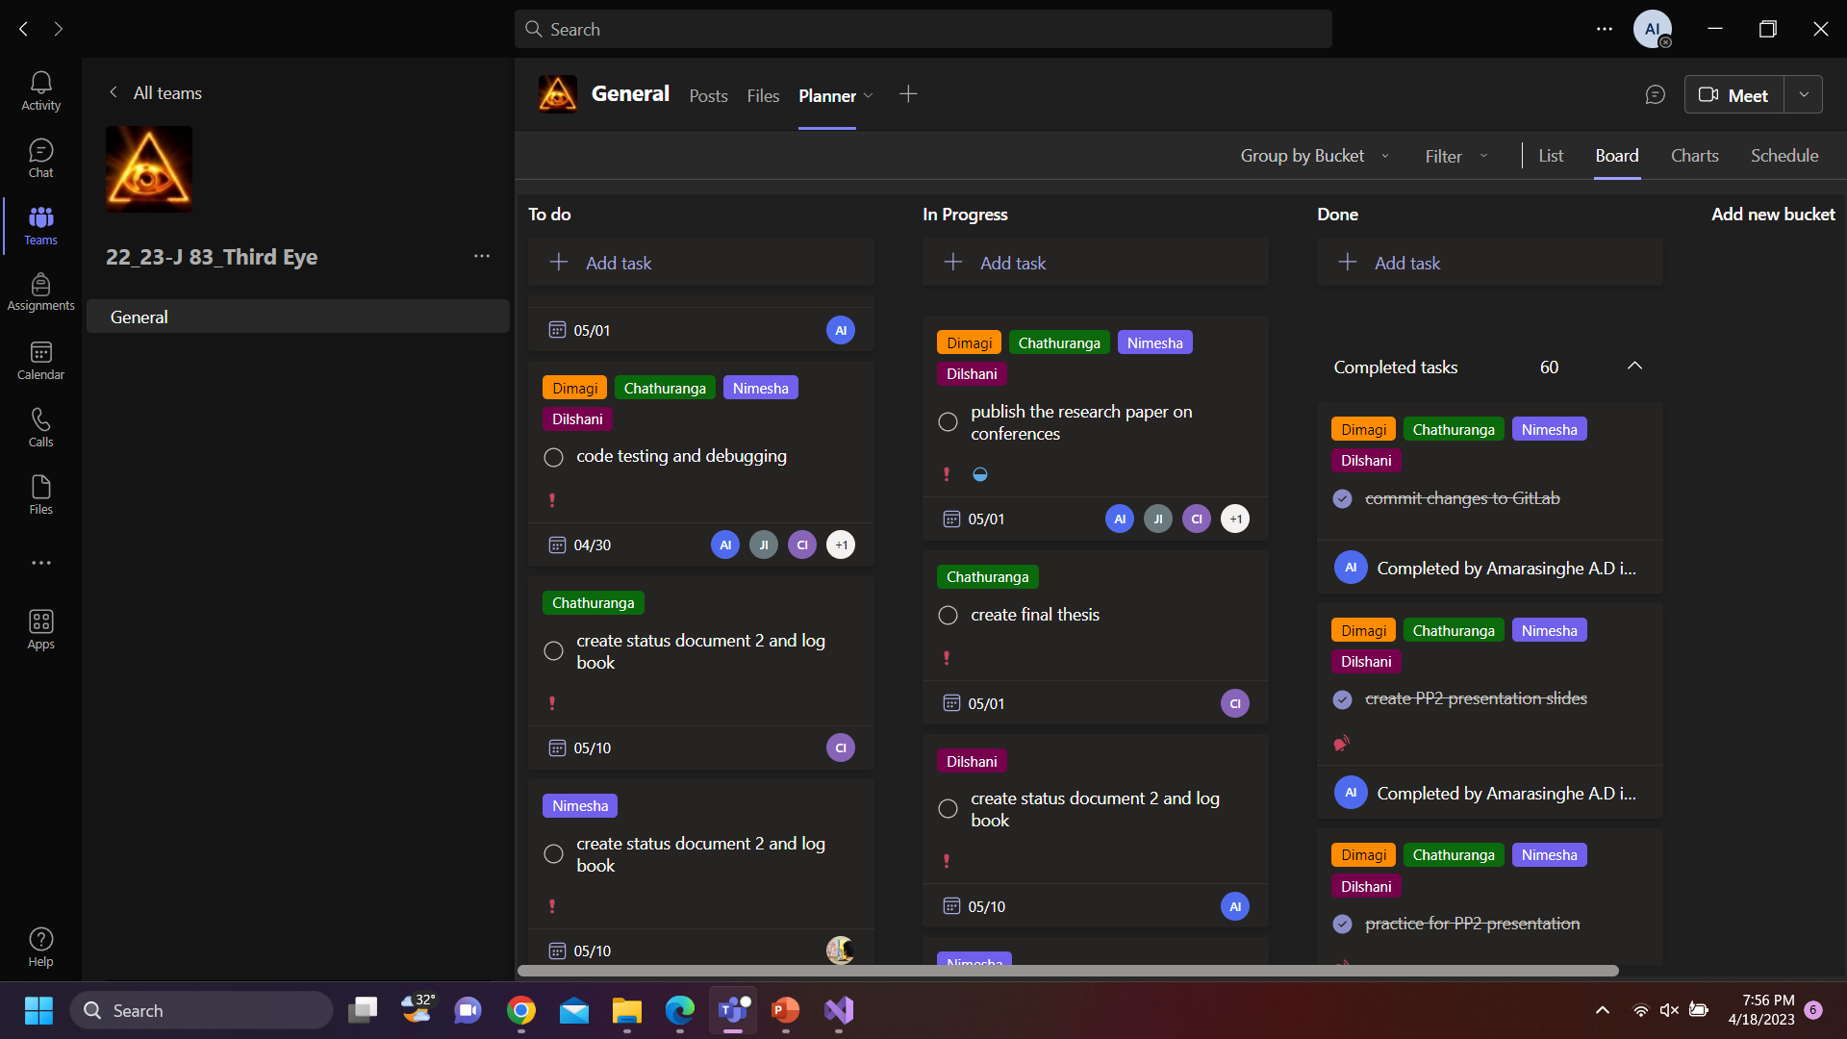





BEST PRACTICES
20/04/2023

Slide 64



BEST PRACTICES
20/04/2023

Slide 65
REFERENCES
• https://www.educative.io/courses/build-your-own-chatbot-inpython/qAA5 mKY19Gp
• https://towardsdatascience.com/reading-color-blindness-charts-deeplearning-and
-computer-vision-a8c824dd71cd
• https://pyimagesearch.com/2017/09/11/object-detection-with-deeplearning
-and-opencv/
• https://datascienceparichay.com/article/distance-between-two-pointspython/
• https://phdservices.org/currency-recognition-using-opencv-python/
20/04/2023

Slide 66

THANK YOU !

